Slide 1
SOLID PRINCIPLES
Better way to code
PRESENTATION BY
JATIN DAVE

Slide 2
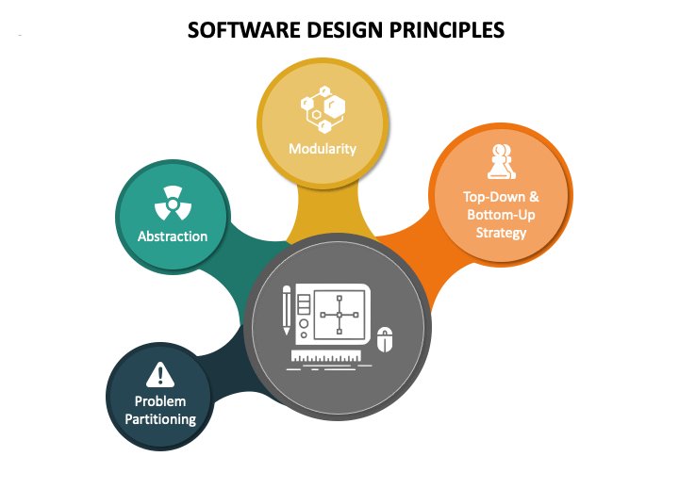
SOFTWARE DESIGN PRINCIPLES
Design principle is a framework for the designer to follow as good software practices.
Design principles provide high level guidelines to design better software applications.
They do not provide implementation guidelines and are not bound to any programming language.
The SOLID (SRP, OCP, LSP, ISP, DIP) principles are one of the most popular sets of design principles.

Slide 3
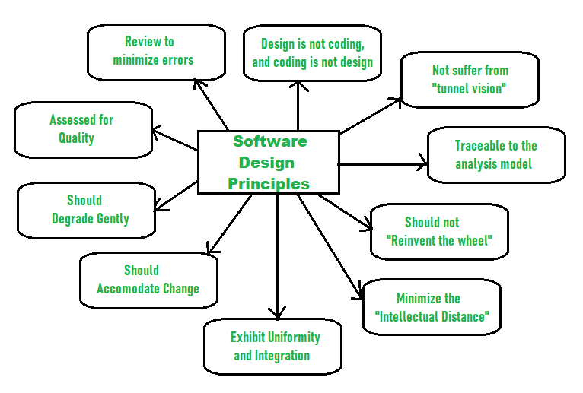
WHY NEED OF SOFTWARE DESIGN PRINCIPLES?
Software designs is a process to plan or convert the software requirements into software systems. There are several principles are used to organize and arrange structural component of software design.
Should not suffer from “Tunnel Vision” – Not only focus on completeness but also on other effects.
Traceable to analysis model - Fulfill all requirements.
Should not “Reinvent The Wheel” - Should not waste time or effort in creating things that already exist.
Minimize Intellectual distance - Reduce the gap between real-world problems and software solutions.
Exhibit uniformity and integration- Uniform throughout the process without any change.
Accommodate change – Adjust the change as per user’s need.
Degrade gently - Work properly even if an error occurs during the execution.
Assessed for quality - The quality of the design needs to be checked and focused.
Review to discover errors – Review design timely to minimize errors
Design is not coding and coding is not design – Design is describing the logic of program and coding is implementation of design

Slide 4
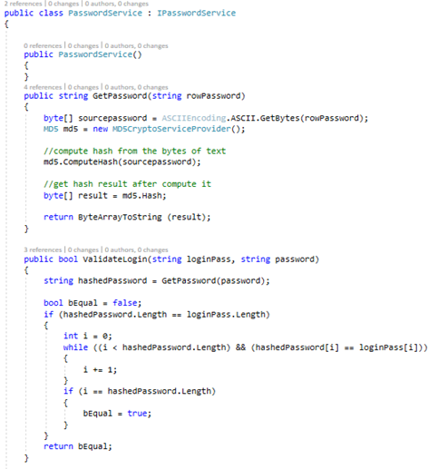

REVISIT - INTERFACE
Contract between itself and any class that implements it.
It contains only declaration of its members and Implementor must implement all of interface members.

Slide 5
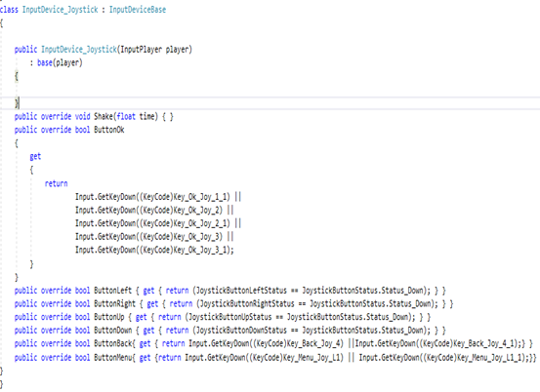
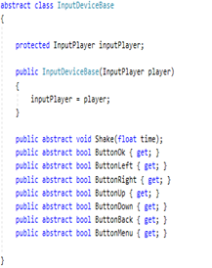
REVISIT - ABSTRACTION
An instance of an abstract class can not be created.
A class inherits from the abstract class need to implement all its abstract members.
Abstract class can contains non abstract methods but at least one abstract method.

Slide 6
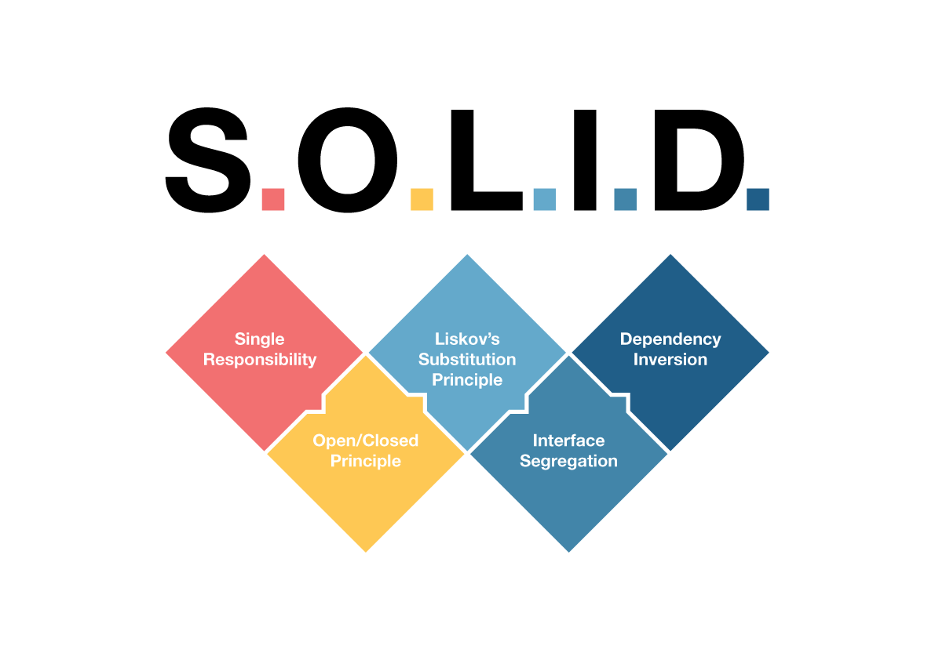
SOLID PRINCIPLES
SOLID Design principles are Introduced by Robert. C. Martin. The SOLID software principles will guide you to:
Write code that’s easy to maintain.
Make it easier to extend the existing system.
Write code that’s easy to read and understand.
S
SINGLE RESPONSIBILITY PRINCIPLE
O
OPEN/CLOSED PRINCIPLE
L
LISKOV SUBSTITUTION PRINCIPLE
I
INTERFACE SEGREGATION PRINCIPLE
D
DEPENDENCY INVERSION PRINCIPLE

Slide 7
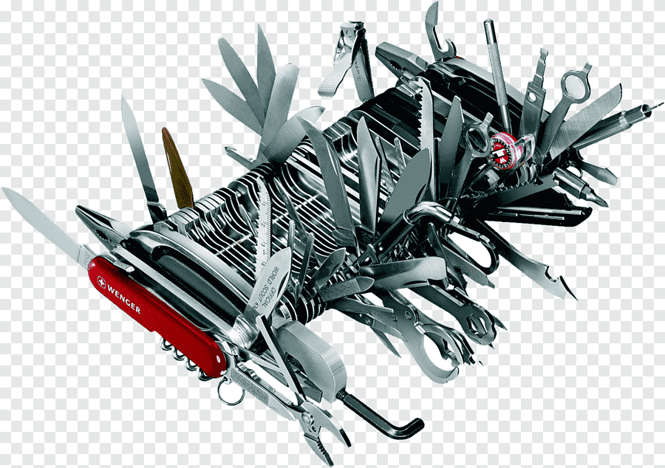
SINGLE RESPONSIBILITY PRINCIPLE
A class (or method) should only have one responsibility hence only one reason to change
Benefits:
Easier to understand and maintain.
Change less frequently.
Easy to Test

Slide 8
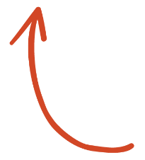
DEMO
SHOW ME

Slide 9



OPEN /CLOSED PRINCIPLE
A class should be open for extension but closed for modification
Benefits
Not allowing modification limits introducing new bugs
All dependent classes will not need to adapt modification

Slide 10
DEMO
WOW !!!

Slide 11
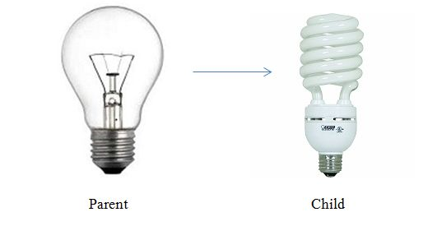
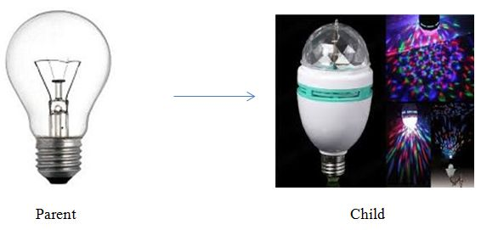
LISKOV SUBSTITUTION PRINCIPLE
It is a principle of OOP and states that derived classes should be able to extend their base classes without changing/affecting their behavior.
It is an extension of the Open Close Principle and is violated when you have written code that throws "not implemented exceptions"
Benefits
No surprising behavior for callers when substitution applies.
Code reusable and loosely coupled.
Perfect Substitution
Violation Substitution

Slide 12
DEMO
INTERESTING !!!

Slide 13
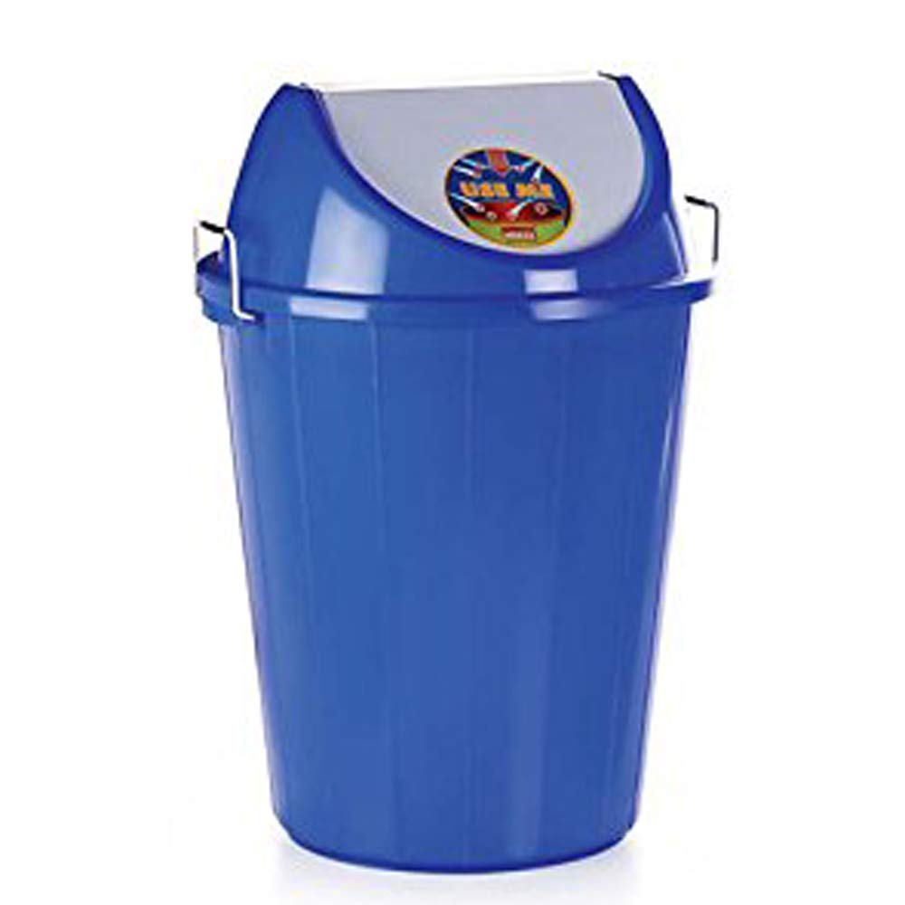
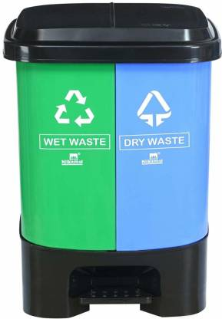
INTERFACE SEGREGATION PRINCIPLE
Client (class implementation interface) should not force to implement Interface that they don't use.
Do not design a big fat interface that forces the client to implement a method that is not required by it, instead design a small interface
Benefits:
Normalizing code.
Easier to manage and test.

Slide 14
DEMO
Excellent !!!

Slide 15
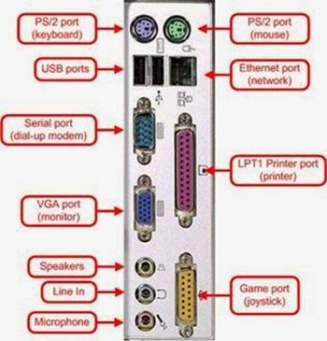
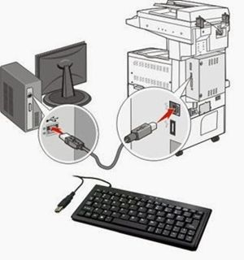
DEPENDENCY INVERSION PRINCIPLE
High-level modules should not depend on low level modules and vice versa, both should depend upon abstraction.
No tight coupling should be among components (Viz. modules, classes) of software and to avoid that, they should depend on abstraction.
Benefits:
Parallel development of the module becomes easy
Allow mock testing efficiently.

Slide 16
DEMO
It should be last one

Slide 17


Any Questions?
Github Code Link

